Slide 1

Weather Forecasting Prediction Using Machine Learning Techniques
PBR
VISVODAYA INSTITUTE OF TECHNOLOGY AND SCIENCE
Kavali-524201,S.P.S.R Nellore(Dt),Ph:08626-243930
Presented by
Kelvin Batch -12
P.Geethika –21735A0414
N.Karthik -21735A0419
P.Madhulatha -20731A04F8
P.Hemadri -20731A04F5
B.Prasanna Kumar Reddy -19731A0480
Guide Name: Mr.A.Venka Reddy
Assistant Professor

Slide 2
Index
Introduction
Abstract
Literature survey
Block diagram
Advantages & Disadvantages
Proposed algorithm
Conclusion

Slide 3
Introduction(DIP)
The digital image processing deals with developing a digital system that performs operations on an image.
Types of images : Binary image , Gray scale image, RGB colour image, RGBA image.

Slide 4
Applications
Image Sharpening & restoration
Medical field
Remote sensing
Transmission & Encoding
Pattern recognition
Video processing
Microscopic imaging

Slide 5
Abstract
This project explores the application of machine learning techniques, specifically Facebook's Prophet Algorithm, in weather forecasting.
Prophet has gained popularity for its effectiveness in time series forecasting tasks due to its simplicity, flexibility and robustness.
It’s provides an overview of Prophet's methodology, emphasizing its ability to automatically detect seasonality, handle missing data, and incorporate external factors such as holidays and special events.
Furthermore, we examine the practical applications of Prophet in weather forecasting, including short-term predictions of temperature, precipitation, and wind pattern.

Slide 6
Introduction
Weather forecasting is the process of predicting atmospheric conditions over a specific time period and geographical area.
The primary goal of weather forecasting is to provide accurate and timely information to help individuals, businesses, and governments make informed decisions and mitigate the impact of weather-related events.

Slide 7
Prediction model (Prophet)
Prophet is an open-source forecasting tool developed by Facebook's Core Data Science team.
Prophet is widely used for forecasting in various domains, including business, finance, economics and environmental sciences.
Key features of Prophet include:
  Automatic Seasonality Detection
  Flexible Trend Modeling
  Holiday Effects
  Scalability

Slide 8
Contd..
Automatic Seasonality Detection: Prophet automatically detects multiple seasonalities in the data, such as weekly, monthly, and yearly patterns.
Flexible Trend Modeling: Prophet allows for flexible trend modeling, accommodating non-linear trends and abrupt changes in the data.
Holiday Effects: Prophet can incorporate holiday effects into the forecasting model.
Uncertainty Estimation: Prophet provides uncertainty intervals around the forecasted values, allowing users to assess the reliability of the forecasts.

Slide 9
Literature survey
For this purpose, analysis of different data mining procedure is performed.
Classification is a data mining (machine learning) method used to predict aggregate participation for information cases.

Slide 10
Basic block diagram
Weather dataset
Observations
Data preprocessing
Quality assurance
Prediction model
Predictions
Weather forecast products
Model analysis

Slide 11
Contd..
Advantages
Risk Mitigation
Increased Safety
Improved Planning and Decision-Making
Disadvantages
Uncertainty
Communication Challenges
Economic Impact

Slide 12
Applications
Emergency Management
Agriculture
Renewable Energy
Transportation
Public Safety

Slide 13
Proposed method
Data Collection and Preparation
Model Selection
Model Training
Prediction
Evaluation and Visualization

Slide 14
Proposed method
Step 1: Data Collection and Preparation:
  Gather historical data related to the variable of interest (e.g., temperature, humidity). Ensure the data is of high quality and free from missing values or outliers.
Step 2: Model Selection:
Choose a suitable forecasting model based on the characteristics of the data and the desired prediction horizon.
Step 3: Model Training
Fit the chosen model to the historical data. The Prophet model is trained using the `fit()`method with the prepared data.

Slide 15
Forecasting data
ds y humidity windspeed mean pressure year month
0 2013-01-01 10.000000 84.500000 0.000000 1015.666667 2013 1
1 2013-01-02 7.400000 92.000000 2.980000 1017.800000 2013 1
2 2013-01-03 7.166667 87.000000 4.633333 1018.666667 2013 1
3 2013-01-04 8.666667 71.333333 1.233333 1017.166667 2013 1
4 2013-01-05 6.000000 86.833333 3.700000 1016.500000 2013 1
... ... ... ... ... ... ... ...
1457 2016-12-28 17.217391 68.043478 3.547826 1015.565217 2016 12
1458 2016-12-29 15.238095 87.857143 6.000000 1016.904762 2016 12
1459 2016-12-30 14.095238 89.666667 6.266667 1017.904762 2016 12
1460 2016-12-31 15.052632 87.000000 7.325000 1016.100000 2016 12
1461 2016-01-01 10.000000 100.000000 0.000000 1016.000000 2016 1

Slide 16
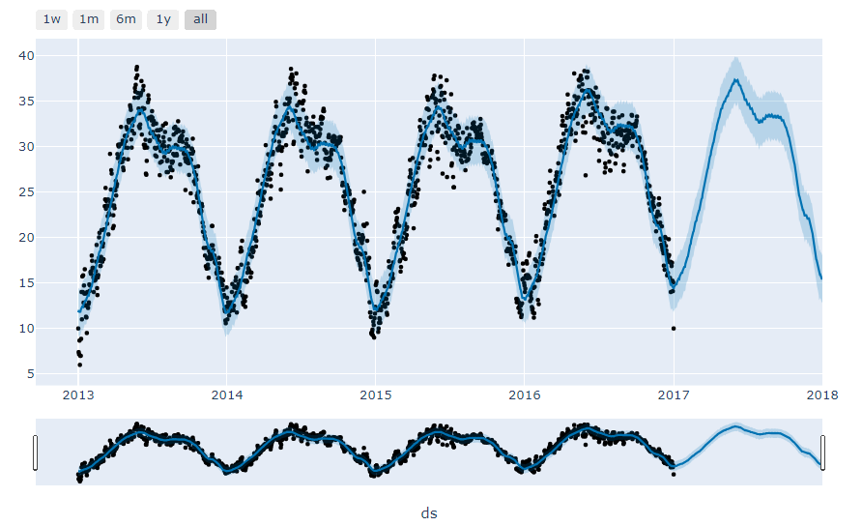
Comparative Graph

Slide 17
Conclusion
In conclusion, we emphasize the potential of Prophet as a valuable tool in the arsenal of weather forecasters, offering improved accuracy, scalability, and ease of use compared to traditional methods. By harnessing the power of machine learning, particularly through algorithms like Prophet, weather forecasting efforts can be enhanced, leading to better preparedness and decision-making in the face of changing weather patterns and extreme events.

Slide 18
Thank you

